Slide 1
Creating greetings card using opengl
Yasar Yousuf ID: 131-15-036
Rayhana Jannat ID:123-15-004

Slide 2
What is OpenGL?
A software interface to graphics hardware
Graphics rendering API (Low Level)
High-quality color images composed of geometric and image primitives
Window system independent
Operating system independent
Notes:
Application Programming Interface

Slide 3
Philosophy of OpenGL
Platform independent
Window system independent
Rendering only
Aims to be real-time
Takes advantage of graphics hardware where it exists
State system
Client-server system
Standard supported by major companies

Slide 4
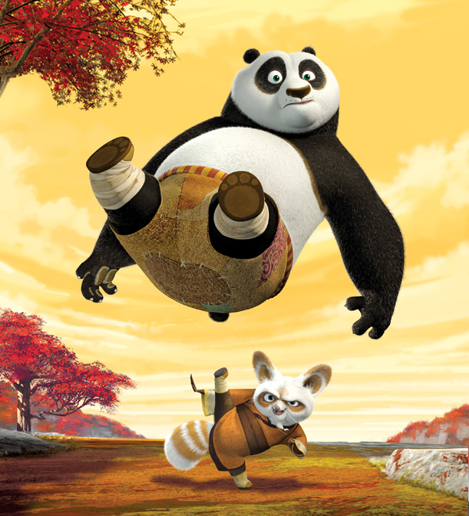
OpenGL Basics
Rendering
Typically execution of OpenGL commands
Converting geometric/mathematical object descriptions into frame buffer values
OpenGL can render:
Geometric primitives
Lines, points, polygons, etc…
Bitmaps and Images
Images and geometry linked through
texture mapping
Graphics Pipeline

Slide 5
OpenGL and GLUT
GLUT (OpenGL Utility Toolkit)
An auxiliary library
A portable windowing API
Easier to show the output of your OpenGL application
Not officially part of OpenGL
Handles:
Window creation,
OS system calls
Mouse buttons, movement, keyboard, etc…
Callbacks

Slide 6
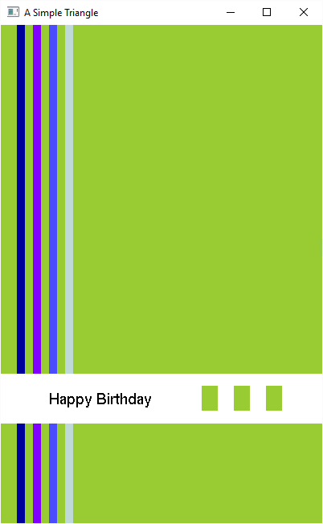
A simple Greetings Card Made with help of OpenGL

Slide 7
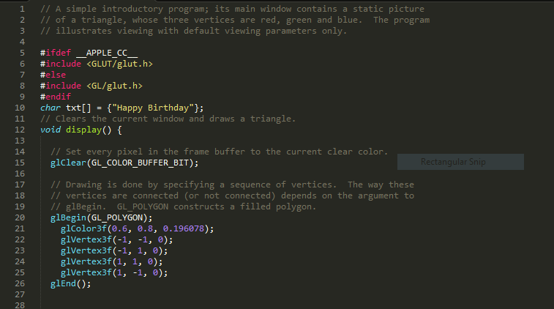
Source code

Slide 8
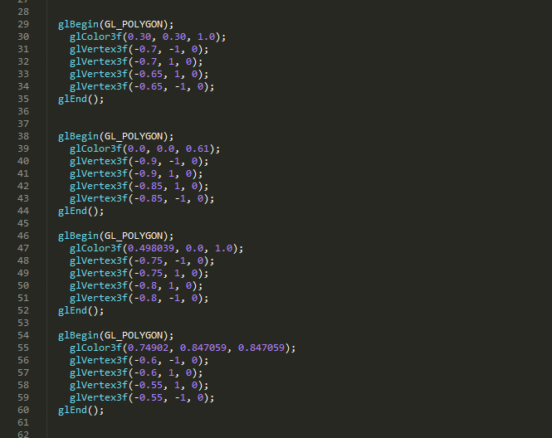
Source code

Slide 9
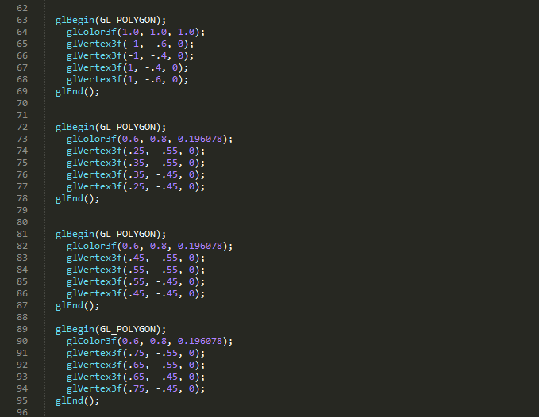
Source code

Slide 10
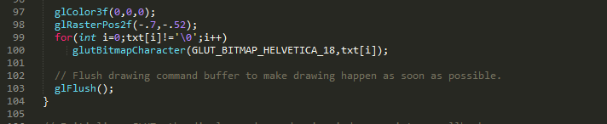
Source code

Slide 11
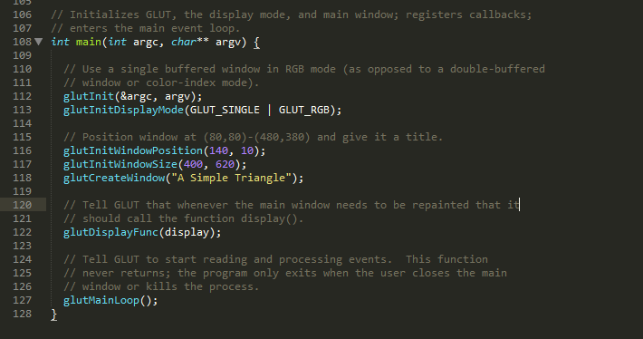
Source code

Slide 12
Thank You

